Slide 1

Dynamic AI Text Analysis Platform
An interactive NLP-powered web application for intelligent text processing and analysis
Presented by SAI AKHIL JAYANTH

Slide 2

OVERVIEW
Transforming Text Into Actionable Insights
Our web-based platform empowers users to analyse and summarise complex text data with unprecedented ease. Whether you're processing research papers, business documents, or social media content, the platform delivers deep insights through advanced natural language processing.
The system seamlessly handles both manual text input and document uploads, making sophisticated text analysis accessible to everyone from researchers to content strategists.

Slide 3



CAPABILITIES
Comprehensive NLP Feature Suite
Flexible Input Methods
Manual text entry or upload documents in multiple formats including PDF, DOCX, and spreadsheets
Intelligent Preprocessing
Advanced cleaning and tokenisation prepare your text for optimal analysis
Smart Summarisation
LexRank algorithm via Sumy extracts the most relevant sentences automatically
Sentiment Analysis
TextBlob-powered emotional tone detection reveals underlying sentiment patterns
Keyword Extraction
Identify critical terms and phrases that define your content
Topic Modelling
LDA and NMF algorithms uncover hidden thematic structures
Word Cloud Visualisation
Create stunning visual representations of term frequency and importance

Slide 4



TECHNOLOGY
Built on Industry-Leading Tools
Frontend
Streamlit provides an intuitive, responsive interface that makes complex NLP accessible to non-technical users
Backend
Python powers the core processing engine with robust, scalable architecture
NLP Libraries
NLTK, TextBlob, Sumy, Scikit-learn deliver state-of-the-art natural language processing capabilities
Visualisation
Matplotlib, WordCloud transform data into compelling visual narratives
File Processing
PyPDF2, python-docx, openpyxl, pandas ensure seamless handling of diverse document formats

Slide 5
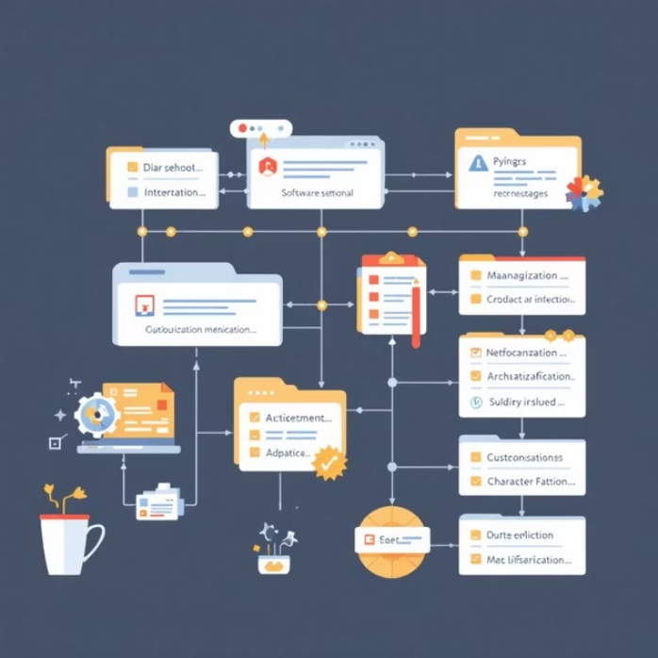
ARCHITECTURE
Modular Project Structure
app.py
Streamlit application interface — the user-facing layer that orchestrates all interactions
backend.py
Core business logic — implements all NLP algorithms and analysis functions
preprocessing.py
Text preprocessing module — handles cleaning, normalisation, and tokenisation
venv/
Virtual environment — isolates dependencies for consistent deployment
__pycache__/
Compiled Python files — optimises performance through bytecode caching
Clean separation of concerns ensures maintainability and scalability as features expand

Slide 6

PROCESS
Seamless Analysis Workflow
Input
User provides text directly or uploads documents in supported formats
Preprocessing
Text undergoes cleaning, normalisation, and tokenisation to prepare for analysis
NLP Analysis
Multiple modules perform summarisation, sentiment analysis, keyword extraction, and topic modelling simultaneously
Visualisation
Results are rendered through interactive charts, word clouds, and structured summaries
Delivery
Insights are presented in an intuitive dashboard ready for interpretation and action

Slide 7

Real-World Applications
Academic Research
Accelerate literature reviews by quickly summarising and extracting key themes from research papers. Identify trends across multiple studies and discover emerging topics in your field.
Business Intelligence
Analyse customer feedback, reviews, and survey responses at scale. Extract actionable insights from market research and competitive analysis documents.
Content Strategy
Evaluate social media sentiment, optimise messaging, and identify trending topics. Create data- driven content strategies based on keyword and topic analysis.

Slide 8

Performance Metrics
5
NLP Techniques
Integrated analysis methods
8
File Formats
Supported document types
100%
Web-Based
Accessible anywhere
The platform processes documents of varying sizes efficiently, delivering results in seconds whilst maintaining accuracy across all NLP operations. Our modular architecture ensures consistent performance even as new features are added.

Slide 9

Ready to Transform Your Text Analysis
Proven Integration
Demonstrates seamless fusion of NLP capabilities with modern web technologies
Broad Applicability
Valuable for academics,
researchers, content analysts, and business professionals
Production Ready
Fully deployed and accessible via intuitive web interface
This platform represents the convergence of sophisticated NLP algorithms and user-centred design, making advanced text analysis accessible to
everyone.

